Slide 1
INTRODUCTION TO TABLEAU
By: Tushar Goel
BDS BATCH
25 MAY

Slide 2
WHAT IS A TABLEAU
Tableau is a data visualization tool or business intelligence tool which analyzes and shows data in the form of chart or report. It is very easy to use, because it does not require any programming skill.
Tableau is a powerful data visualization tool. Tableau helps us to analyze the raw data in (pictorial form) or in the form of the visual manner, it may be graph, report, etc.
Data Analysis is very fast with Tableau, and visualization created are in the form of worksheets & dashboards.
Tableau is easy, powerful and fast and help in taking important business decision.
we don’t need any prior coding skill or technical background in order to learn tableau.
These BI tools are so powerful that it can work on large amount of data & can convert in into meaningful formats.

Slide 3
WHY TABLEAU
Business Driven Solutions.
Converting raw data into meaningful insights.
Visual Analytics.

Slide 4
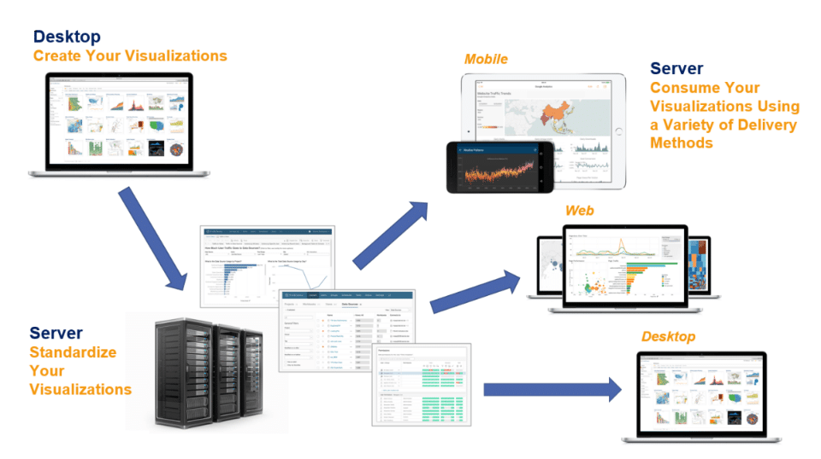
TABLEAU ARCHITECTURE.

Slide 5
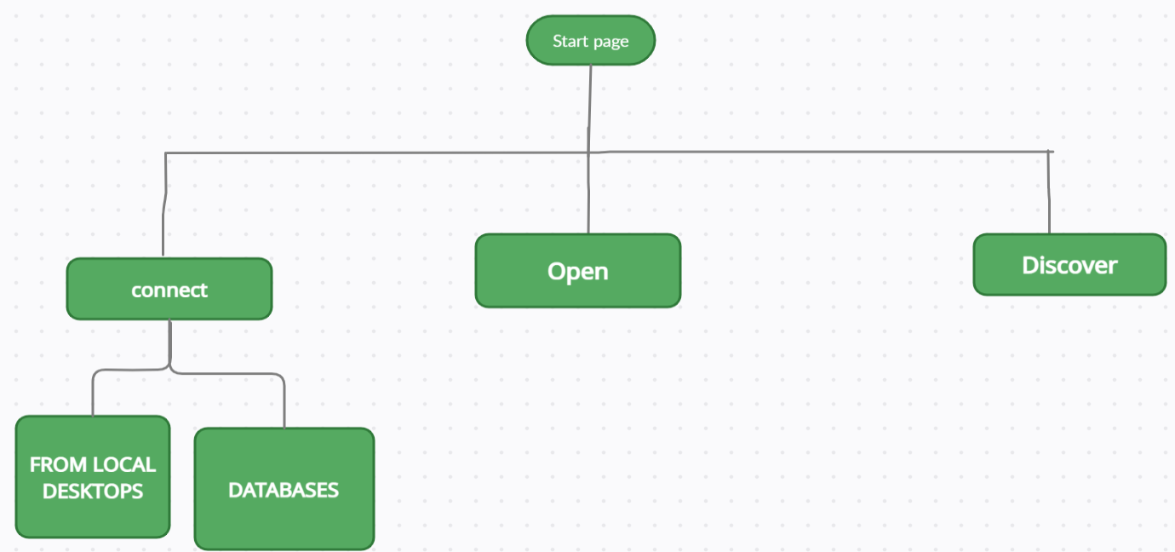
SEVERAL OPTIONS ON THE START PAGE OF TABLEAU DESKTOP

Slide 6
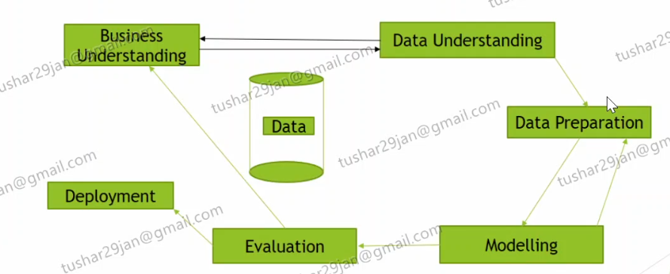
Process flow of bi project
Business understanding
Data understanding
Data preparation
Modelling
Evaluation
Deployment

